Slide 1
SMARTWAYS:Roadways that genrate energy
Problem statement:Due to increase in population, overall energy consumption increases so to overcome this problem we aim to develop smart roadways.
MEMBERS:-Sonam 2401420016
Shashwat 2401420025

Slide 2
INTRODUCTION
These roads integrate solar technology to generate electricity, which can power streetlights, traffic signals, electric vehicle (EV) charging stations, and smart road systems and some of these PV systems are equipped with heating elements or coatings to melt snow and ice off the panels.
Objectives
1. Power smart lighting, traffic signals, and sensor-based monitoring systems to improve traffic management.
2. Provide energy for on-road wireless EV charging stations to encourage the adoption of electric mobility.
3. Utilize existing road surfaces for solar energy generation, minimizing the need for separate land for solar farms.

Slide 3
GLOBAL RESEARCH
Netherlands: SolaRoad
In 2014, the Netherlands introduced SolaRoad, a pioneering project featuring a 72-meter-long bike path embedded with solar panels in Krommenie.
France: Wattway
France launched the Wattway project, installing solar panels on a 1-kilometer stretch of road in Tourouvre-au-Perche in 2016.
South Korea: Solar-Powered Bike Lane
South Korea has developed a solar-powered bike lane along a 32-kilometer stretch between Daejeon and Sejong.

Slide 4
BACKGROUND AND FEASIBILITY
Initial installation costs are high, but long-term savings on energy can make the system cost-effective.
Adaptation for India’s diverse climate, from extreme heat to monsoons, is necessary.
Research is still in early stages, with prototypes being tested worldwide.

Slide 5
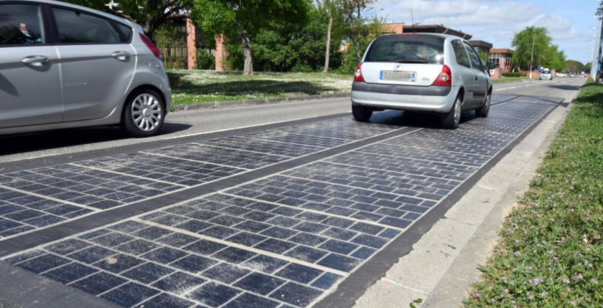
EXAMPLE:-

Slide 6
INNOVATION AND NOVELTY
Embedding smart sensors within solar panels enables roads to collect real-time data on traffic flow, road conditions, and energy generation.
Self-cleaning coatings and snow-shedding technologies applied to the surface of photovoltaic panels can ensure that roads remain clear of snow, or dirt, maximizing sunlight exposure and energy production.
Self-heating road surfaces powered by solar energy could prevent ice formation in winter.

Slide 7
APPLICATION OR USABILITY
Powering Streetlights & Traffic Signals.
Can serve as emergency power sources.
Charge electric vehicles using energy stored.
Melt snow and ice off the panels.
Can power security systems in urban areas.

Slide 8
TECHNOLOGY USED
Front-End (User-facing interfaces):
Dashboard Displays: Real-time energy output visuals for users.
Mobile Apps: Interfaces showing energy savings and vehicle data.
Interactive Maps: Show energy-generating road sections and performance.
Back-End (Server, processing, and data systems):
IoT Sensors & Data Collection: Gather traffic, pressure, heat, and energy metrics.
Cloud Computing: Stores and analyzes energy production and road usage data.
AI Algorithms: Optimize traffic flow and maximize energy generation efficiency.
Blockchain: Securely track and verify energy transactions.
UI/UX Design (User experience and interaction):
Responsive Design: Adapts energy data dashboards to all devices.
Data Visualization: Graphs and charts for intuitive understanding of energy metrics.
Minimalist Interfaces: Simplifies user interaction with smartway systems.
4. Accessibility Features: Voice, contrast, and layout options for inclusivity.

Slide 9
CHALLEGES
Roads are subjected to constant wear and tear due to vehicle traffic, weather condition and environmental factors like UV radiation.
The initial installation cost of PV panels on roads is significant.
The need for regular maintenance and repair is a significant challenge.
In some regions, such as those with heavy snow, rain, or extreme heat, the performance of solar panels can be negatively affected.
OVERCOMES
1. Anti-scratch, and weather-resistant coatings can be applied to panels to reduce damage from weather conditions.
2. Governments could partner with private enterprises to fund the installation of solar roads.
3. Use of modular PV panel systems that can be easily replaced or repaired.
4. Solar roads in colder regions can be equipped with self-heating elements powered by solar energy to prevent snow and ice buildup

Slide 10
CONCLUSION
Photovoltaic panels in self-powered smart roads offer a sustainable solution for energy harvesting, reducing reliance on traditional power grids.
By integrating solar power into transportation infrastructure, these roads enhance efficiency,and support electric vehicle charging.This project aims to make roads energy-efficient, cost-effective, and resilient for future smart cities.

Slide 11


